Slide 1
CAP’NN: Class-Aware Personalized Neural Network Inference
DAC 2020

Slide 2
Background & Motivation
Background
Larger models + larger data->better accuracy, limit on memory and computation resources.
Prune: Cloud Training, edge inference.
Problem
individual user only encounters a tiny fraction of the trained classes -> trained models for all classes is not necessary.
Motivation
simply retraining bespoke neural network models for every user is not cost-effective -> a personalized inference framework -> prune the trained model based on edge data -> smaller and personalized model -> minimize the memory and computation overheads on the local device.

Slide 3
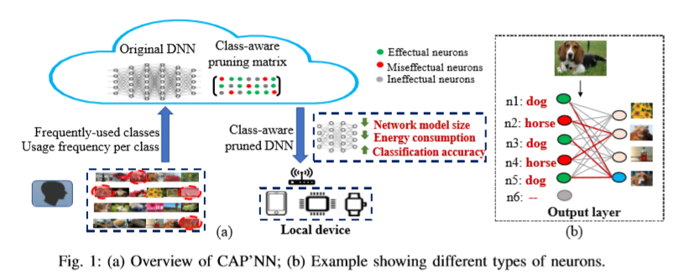
Overview
Effectual Neurons: neurons that are active for edge data.
Miseffectual Neurons : neurons that are useful but non-active for edge data.
Ineffectual Neurons: neurons that have low contribution to the final classification.

Slide 4
Detail
CAP’NN-Basic pruning (CAP’NN-B) : uses the class-specific firing rates -> first find a subset of neurons to be pruned for each output class while maintaining the per-class accuracy degradation below a threshold->The neurons that get pruned are thus ineffectual for a user-specified subset of classes.
CAP’NN-Weighted pruning(CAP’NN-W): considers the likelihood of encountering each class -> estimate an effective firing rate for each neuron -> extends this to account for the expected per-class usage for each individual user, leading to more aggressive pruning.
CAP’NN-Miseffectual pruning (CAP’NN-M) :enables pruning of miseffectual neurons in addition to the ineffectual ones already pruned by CAP’NN-W -> identifies and prunes neurons that work against the correct classification of the user classes.

Slide 5
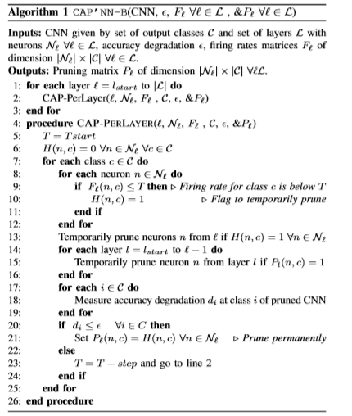
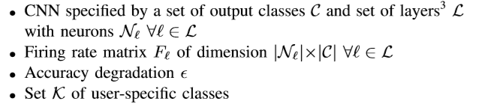
Detail
CAP’NN-Basic pruning (CAP’NN-B) : prune the ineffectual neurons-> not consider the preference of users.
a one-time process offine

Slide 6
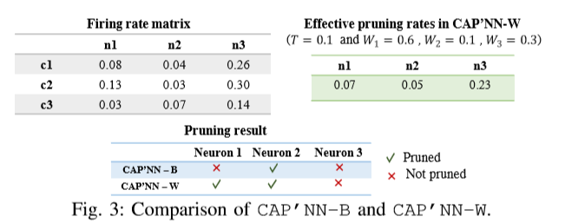
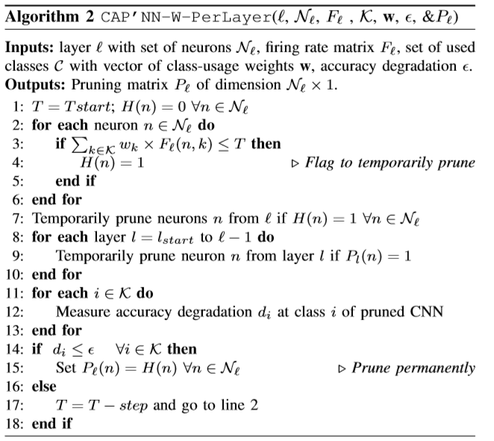
Detail
CAP’NN-Weighted pruning(CAP’NN-W): prune ineffectual neurons> considering the preference of users.
a many-time process online

Slide 7

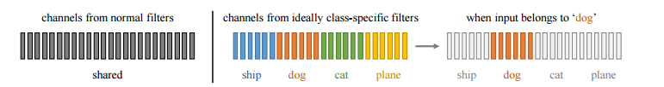
Detail
CAP’NN-Miseffectual pruning (CAP’NN-M) :
The final layer(dense)
a one-time process offline
Steps:
Finding Top Confusing Classes :identify the top-5 classes that have the highest probability of being triggered during inference.
Finding Miseffectual Neurons for Top Confusing Classes:

Slide 8
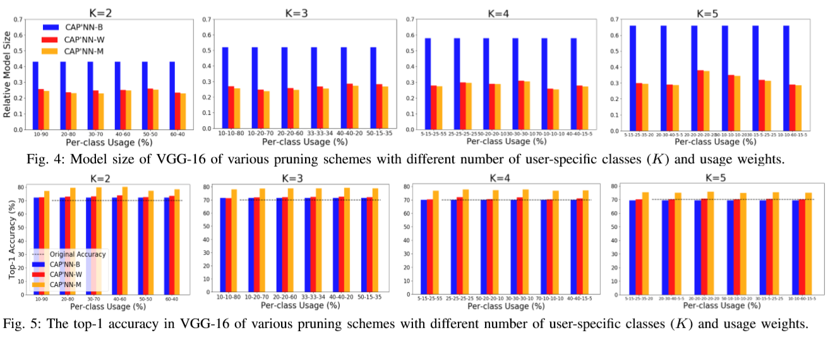
RESULTS AND DISCUSSION
VGG-16: 13 convolutional layers and 3 fully connected layers + ImageNet (2012)

Slide 9
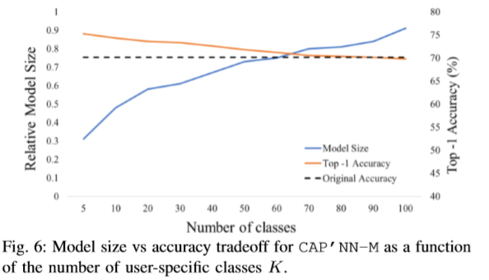
RESULTS AND DISCUSSION
A higher K increases the relative model size because it makes the pruning more conservative.
100 user-specified classes, the relative model size is 90% of the original model, so small K is better.

Slide 10
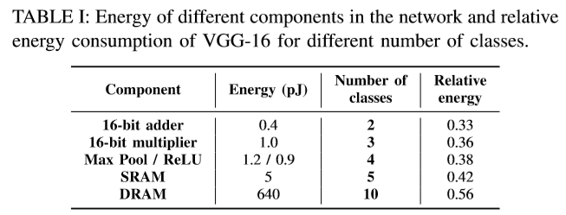
RESULTS AND DISCUSSION
As can be seen, CAP’NN can achieve energy savings of up to 44% relative to the original model.

Slide 11
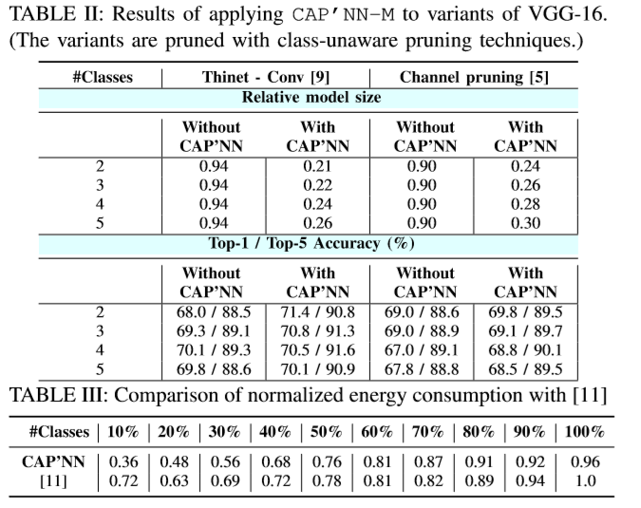
RESULTS AND DISCUSSION

Slide 12
收获
逻辑：从单纯的根据数值的大小减去无效神经元->基于用户的数据进一步减去无效的神经元->基于用户的数据减去最后一层的神经元。
问题：
依赖于阈值的剪枝工作的参数怎么设计和调整（firing matrix）。
实验的设计：在训练集上训练，在测试集上测试，没有完全模拟出来端云数据之间的差异性。
将数据的分布上传到网上，数据隐私。
收获：
实验关于能耗的部分

